Slide 1

DEEP DIVE:
SAP BDC With Snowflake
May 2026

Slide 2
Safe Harbor and Disclaimers
REV 01.05.24
Other than statements of historical fact, all information contained in these materials and any accompanying oral commentary (collectively, the “Materials”), including statements regarding (i) Snowflake’s business strategy, plans or priorities, (ii) Snowflake’s new or enhanced products, services, and technology offerings, including those that are under development or not generally available, (iii) market growth, trends, and competitive considerations, (iv) our vision for Snowpark, the Data Cloud, and industry-specific Data Clouds, including the expected benefits and network effects of the Data Cloud; and (v) the integration, interoperability, and availability of Snowflake’s products, services, or technology offerings with or on third-party platforms or products, are forward-looking statements. These forward-looking statements are subject to a number of risks, uncertainties and assumptions, including those described under the heading “Risk Factors” and elsewhere in the Annual Reports on Form 10-K and the Quarterly Reports on Form 10-Q that Snowflake files with the Securities and Exchange Commission. In light of these risks, uncertainties, and assumptions, the future events and trends discussed in the Materials may not occur, and actual results could differ materially and adversely from those anticipated or implied in the forward-looking statements. As a result, you should not rely on any forwarding-looking statements as predictions of future events. Forward-looking statements speak only as of the date the statements are first made and are based on information available to us at the time those statements are made and/or management's good faith belief as of that time. Except as required by law, we undertake no obligation, and do not intend, to update the forward-looking statements in these Materials.
Any future product or roadmap information (collectively, the “Roadmap”) is intended to outline general product direction. The Roadmap is not a commitment, promise, or legal obligation for Snowflake to deliver any future products, features, or functionality; and is not intended to be, and shall not be deemed to be, incorporated into any contract. The actual timing of any product, feature, or functionality that is ultimately made available may be different from what is presented in the Roadmap. The Roadmap information should not be used when making a purchasing decision. In case of conflict between the information contained in the Materials and official Snowflake documentation, official Snowflake documentation should take precedence over these Materials. Further, note that Snowflake has made no determination as to whether separate fees will be charged for any future products, features, and/or functionality which may ultimately be made available. Snowflake may, in its own discretion, choose to charge separate fees for the delivery of any future products, features, and/or functionality which are ultimately made available.
The Materials may contain information provided by third-parties. Snowflake has not independently verified this information, and usage of this information does not mean or imply that Snowflake has adopted this information as its own or independently verified its accuracy.
© 2026 Snowflake Inc. All rights reserved. Snowflake, the Snowflake logo, and all other Snowflake product, feature and service names mentioned in the Materials are registered trademarks or trademarks of Snowflake Inc. in the United States and other countries. All other brand names or logos mentioned or used in the Materials are for identification purposes only and may be the trademarks of their respective holder(s). Snowflake may not be associated with, or be sponsored or endorsed by, any such holder(s).
Notes:
If you are planning to share these slides externally (customers, partners, prospects, events, etc.):
You must include this Safe Harbor and Disclaimers slide as the first or second slide of your presentation.
You must ensure that the “© 2025 Snowflake Inc. All Rights Reserved” footer is at the bottom of each slide.
You must ensure that all references to products and features that are not generally available are appropriately tagged as in development, in public preview, or in private preview within the slides.

Slide 3
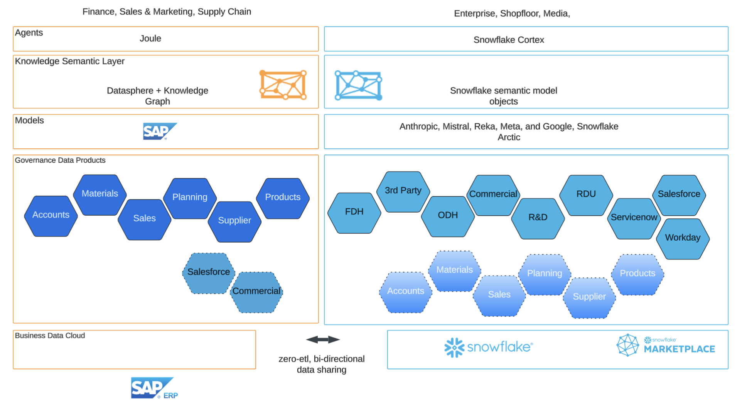
Activate BDC data products in Snowflake and vice-versa
BDC Data Products become available through metadata references in Snowflake
Snowflake derived data & AI insights become available in BDC in near real-time
Derived data products and lineage information are available for observability

Slide 4


Zero-Copy Snowflake & SAP
SAP manages the source extractions and transformation layers
Scale
Share
Boost
SAP Ops Systems
SAP Business Data Cloud
SNOWFLAKE
Joule
Business Process AI
AI enabled Self-service for Biz, Engineers, Natural Language Querying Reporting Tools. Connect to Joule
Agent to Agent J
Snowflake Cortex AI
Analytics Cloud
Intelligent Apps Dashboards
Planing
Build Data Supply Chain with your Business Partners Cross-Region, Cross-Cloud
Private Data Exchange
Datasphere /Data product Builder (Q2-AQ3 ‘26)
Analytic models built on data products–not exposed to 3rd parties
Zero-copy Data in Snowflake
Build Listings/Apps/ Agents in Snowflake with mix of SAP & non-SAP (IOT, Social, Documents) sources. Publish objects into BDC Catalog. Use ORD-CSN to expose historical objects to match BDC objects.
ECC - Extractors / Table Replication
ECC - Extractors / Table Replication
FINANCE
ETL or Datasphere
Snowflake Data Products
Historical
Core Data Services Views (Ops reporting)
Private Cloud Edition
Managed & Custom BDC Data Products (semantic layer built on S/4HANA CDS Views)
BDC Object Store
Zero-copy
Data in BDC
Rich Semantics from SAP. Enrich further with Snowflake Marketplace, with Enterprise data, Data Engineering
Semantic Views on BDC DPs
SuccessFactors

Slide 5


SAP BDC Connect for Snowflake
Process flow for existing Snowflake accounts
1. Account Declaration in SAP BDC
2. Data Product Sharing
Snowflake
ORG admin activates BDC connect Terms Of Service and sends the org-account URL to the SAP provisioning user.
SAP User
Accesses me.sap.com, generates invitation link, and adds system to BDC Formation.
Snowflake
Creates catalog integration using invitation link to show catalog integrations.
BDC Admin
Shares one or more data products to Snowflake integration.
Snowflake Workflow
List available BDC shares
Run "Create Catalog Linked Database" (CLD) command
Read BDC Catalog managed data
Create database, schema, and tables
On Roadmap: Automatic Semantic View from ORD-CSN
SNOWFLAKE + SAP BDC
Notes:
Part One;
We are in the process of documenting this, and at a high-level below are the pre-reqs / steps for Brownfield customers. ie. they have an existing Snowflake account.
Overview of CUJ:
Procure SAP BDC and ensure they have BDC Data products available to share
Obtain an SAP BDC invitation link from SAP4ME by providing their Snowflake account URL
Use the UX in SAP to create a formation that includes SAP BDC Connect for Snowflake
In Snowflake, install Openflow, create a deployment & runtime, install the Openflow connector for SAP BDC in runtime, configure the connector with the invitation link & other parameters and run it
Share data products from SAP BDC to Snowflake from step 3
After this, data products shared from SAP BDC to Snowflake will show up as CLDs in Snowflake that they can query and “mash up” with other data in Snowflake.
I'll also note that for Restricted release, we will qualify and invite customers from the list @Liana Shuma maintains, so important to get your candidate customers in there.
Part Deux:
Customers can also create the catalog integration and the CLDs via SQL (as an alternate to step 4) and I've been asked a few times “Why Openflow? Are we doing ETL?”
Here's why: first off, the Openflow connector for SAP BDC is a “zero-copy” connector (likely a first for Openflow!).
It does NOT do ETL; instead, it calls the appropriate catalog integration SQL under the covers to ensure metadata is automatically refreshed in Snowflake.
The Openflow connector for SAP BDC offers the following customer benefits over using straight SQL:
Can create the necessary catalog integration with the provided invitation link. This is useful when customers want to create a new enrollment to the same or different BDC in the same Snowflake account. Ideal for data harmonizing scenarios where you want data products shared from multiple BDCs in the same Snowflake account.
Can use an existing catalog integration instead of requiring an invitation link. This is useful in Greenfield scenarios where our workflow automatically creates a catalog integration as part of account provisioning. This is also useful when you want to share two sets of data products from the same BDC into the same Snowflake account.
When data products are shared from BDC to Snowflake, it automatically discovers them and creates CLDs for them. With SQL, you need to do this manually each time a new data product is shared.
When data products are un-shared from BDC to Snowflake, it drops the CLDs as appropriate. With SQL, you need to do this manually each time a new data product is un-shared.
Lastly, (and probably the best customer value), it automatically obtains the Core Schema Notation (CSN) metadata from BDC for all data products shared, parses them and creates Semantic Views in Snowflake in a DB you specify. This is effectively brings over the rich business object metadata from SAP to Snowflake. This is what turns the raw tables with 5-letter column names into something like “CashflowForecast” and is ideal for scenarios where customers want to “point” Snowflake Intelligence or Cortex Agents to the data products shared from BDC to derive rich insights.
And yes, it automatically drops the appropriate SemViews when data products are un-shared.

Slide 6

Where’s My Data? : Data Gravity
Supported Source Systems for BDC Copy
ECC
S/4 Hana on-premise
S/4 Hana Private Cloud Edition
S/4 Hana Public Cloud Edition
SuccessFactors
Ariba
BDC - Copy
Custom
Datasphere Replication Flow
SNOWFLAKE
Bucket
(S3, AZ, GCP)
Scale
Concurrency
Speed
Stream
Kafka
Build Data Supply Chain with your Business Partners Cross-Region, Cross-Cloud
Public/Private Data Exchange
Support Source Systems for BDC Zero Copy (available flows in parentheses)
S/4 Hana on-premise (Custom, BW PCE)
S/4 Hana Private Cloud Edition (Managed, Custom, BW PCE)
S/4 Hana Public Cloud Edition (Managed, Custom)
SuccessFactors (Managed, Custom)
Ariba (TBD)
ECC (Custom, BW PCE)
BDC - Zero Copy flows
AI enabled Self-service for Biz, Engineers
Natural Language Querying
Reporting Tools
Managed
BDC APRS, Apache Spark, Object Store
Snowflake Intelligence
Rich Semantics from SAP. Enrich further with Snowflake Marketplace, with Enterprise data.
Custom
BDC Datasphere Business Content (S/4)
Datasphere Object Store
Semantic Views & Models
BW PCE
BDC Object Store
Structured Data
Semi-Structured Data
Unstructured Data
Build Listings/Apps/ Agents in Snowflake with mix of SAP & non-SAP (IOT, Social, Documents) sources
BDC Catalog, Datasphere, SAC
FINANCE
Snowflake Data Products

Slide 7
You Have SuccessFactors, S/4HANA Public or Private Cloud? BW?
Use Zero-Copy to leverage curated SAP Data Products in Snowflake
Use Zero-Copy to leverage Snowflake data products in BDC
SNOWFLAKE
SAP
1. APRS replicates S/4HANA PCE initial/delta CDS views to BDC.
2. Apache Spark augments CDS view data with semantic information. Data is stored in Parquet File format. SAP BDC Catalog manages these.
Snowflake
3. Snowflake Horizon Catalog refreshes against BDC Catalog at regular intervals, updating Table DDLs and Snowflake Semantic Views (API call to SAP ORD-CSN in BDC).
4. Snowflake executes queries directly against BDC data using its unified engine and virtual warehouses. Cortex AI&ML & Snowflake all leverage this foundational capability to get and process the data.
Scale
Concurrency
Speed
Build Data Supply Chain with your Business Partners Cross-Region, Cross-Cloud
Public/Private Data Exchange
AI enabled Self-service for Biz, Engineers
Natural Language Querying
Reporting Tools
BDC - Zero Copy flows
Snowflake Intelligence
S/4 Hana Private Cloud Edition
S/4 Hana Public Cloud Edition
SuccessFactors
Managed
BDC APRS, Apache Spark, Object Store
Rich Semantics from SAP. Enrich further with Snowflake Marketplace, with Enterprise data.
4
1
Semantic Views & Models
Custom
BDC Datasphere Business Content (S/4)
Datasphere Object Store
3
Benefits: reduced development and maintenance costs. Certified.
Challenges: relevance of data products. Still need to model on top.
Unstructured Data
Structured Data
Semi-Structured Data
BW PCE
BDC Object Store
Build Listings/Apps/ Agents in Snowflake with mix of SAP & non-SAP (IOT, Social, Documents) sources
BDC Catalog, Datasphere, SAC
FINANCE
Snowflake Data Products
2

Slide 8
Don’t Have S/4HANA Private or Public? Data Products not out yet? No Worries.
use BDC as ELT to Snowflake
Supported Source Systems for BDC as ELT
ECC
S/4 Hana on-premise
S/4 Hana Private Cloud Edition
S/4 Hana Public Cloud Edition
SuccessFactors
Ariba
BDC - Use Datasphere as ELT.
Custom
Datasphere Replication Flow
SNOWFLAKE
Bucket
(S3, AZ, GCP)
1
2
3
Scale
Concurrency
Speed
-Kafka -Snowflake Datastream
Build Data Supply Chain with your Business Partners Cross-Region, Cross-Cloud
Public/Private Data Exchange
Use BDC as ELT to Snowflake when you don’t have S/4HANA Private or Public Edition, or BDC Data Products (DPs) don’t correspond to your business. Cut over to
1. Create SAP Datasphere (DSP) Replication Flows from ERP through Datasphere to
2. S3, ADSLGen2, or GCP Cloud Storage or Streaming
3. Storage integration and Snowpipe are Used, or Kafka is streamed, and data is persisted in Snowflake native Table format (FDN) or Apache Iceberg.
AI enabled Self-service for Biz, Engineers
Natural Language Querying
Reporting Tools
Snowflake Intelligence
Rich Semantics from SAP. Enrich further with Snowflake Marketplace, with Enterprise data.
Semantic Views & Models
Benefits
Single Source of Truth, Single data modeling environment (Snowflake), reduced size of Datasphere as it is not persisting data, SAP-native so no long haggling with SAP. Snowflake Datastream extremely cost-effective. Get started today to mix SAP and non-SAP. As BDC data products become available, easy to cut-over to zero-copy
Challenges
Build your own data products, SAP premium outbound costs can be prohibitive, Datasphere overhead. Sourcing semantic information not automatic.
Pro-Hint
Work with ORD-CSN definitions to build your SAP data products to make later cutover easier.
Structured Data
Semi-Structured Data
Unstructured Data
Build Listings/Apps/ Agents in Snowflake with mix of SAP & non-SAP (IOT, Social, Documents) sources
FINANCE

Slide 9
SAP BDC Copy To Bucket Replication
Datasphere Premium Outbound to Bucket, COPY INTO Snowflake
Use when you want to use SAP as an ETL and have all of your data in Snowflake, raw or CDS views, or legacy ERPs such as ECC. Benefits–backup storage in bucket, single modeling environment (Snowflake) . Challenges–build own data products, SAP premium outbound costs, file handling can be challenging in Azure Gen2.
SAP - Option Replicate to Snowflake without Persisting in BDC
1. SAP Datasphere (DSP) Replication Flows from ERP (S/4HANA on-premise, Cloud, or ECC) through Datasphere to
2. S3, ADSLGen2, or GCP Cloud Storage.
Snowflake
3. Storage integration and Snowpipe are Used and data is persisted in Snowflake native Table format (FDN) or Apache Iceberg.
S/4HANA Private Cloud
S/4HANA On-Premise
ECC
SAP BDC
Snowflake AI Data Cloud
SF Horizon Catalog
SF Virtual Warehouse
SAP Managed CDS Views, BW Extractors, Tables
1
Datasphere Replication Flow
Cloud Storage
Copy Into
3
2
SF Storage

Slide 10
SAP BDC Copy To Stream Replication
Datasphere Premium Outbound to Kafka, Snowpipe to Snowflake
Use when you want to use SAP as an ETL and have all of your data in Snowflake, raw or CDS views, or legacy ERPs such as ECC. Benefits–single storage, single modeling environment, near-real-time, mature handling of data from Kafka. Challenges–build own data products, premium outbound costs. Kafka an extra step.
SAP - Option Replicate to Snowflake without Persisting in BDC
1. SAP Datasphere (DSP) Replication Flows from ERP (S/4HANA on-premise, Cloud, or ECC) through Datasphere to
2. Kafka Topic.
Snowflake
3. In case of Kafka Topic, Snowpipe streaming is used, and data is persisted in Snowflake native Table format (FDN) or Apache Iceberg.
S/4HANA Private Cloud
S/4HANA On-Premise
ECC
SAP BDC
Snowflake AI Data Cloud
3
SF Horizon Catalog
Kafka Topic
Snowpipe streaming
2
SF Virtual Warehouse
SAP Managed CDS Views, BW Extractors, Tables
1
Datasphere Replication Flow
SF Storage
Notes:
How do we know when it’s a delete? Replication flow should capture deletes as well.

Slide 11
SAP BDC Managed Data Products Zero-Copy
Activate Pre-built Data Products in BDC, BDC Connect For Snowflake
Use when you have SAP S/4HANA Private Cloud Edition and want to leverage pre-built SAP Data products. Benefits: reduced development and maintenance costs. Certified. Challenges: relevance of data products. Still need to model on top.
SAP
1. APRS replicates S/4HANA PCE initial/delta CDS views to BDC.
2. Apache Spark transforms CDS view data into SAP managed data products (1 CDS to 1 DP or many CDS to 1 DP). Semantic information encoded using ORD-CSN. Data is stored in Parquet File format. SAP BDC Catalog manages these.
Snowflake
3. Snowflake Horizon Catalog refreshes against BDC Catalog at regular intervals, updating Table DDLs and Snowflake Semantic Views (API call to SAP ORD-CSN in BDC).
4. Snowflake executes queries directly against BDC data using its unified engine and virtual warehouses. Cortex AI&ML & Snowflake all leverage this foundational capability to get and process the data.
S/4HANA Private Cloud
SAP BDC
Snowflake AI Data Cloud
SAP BDC Catalog
SF Horizon Catalog
3
SAP BDC Object Store
4
SF Virtual Warehouse
SAP Managed CDS Views (Operational Reporting Layer)
1
ABAP Push Replication Server / Apache Spark
Apache Iceberg
SF Storage
2
All Snowflake workloads (data engineering, data quality, marketplace, AI/ML, Snowflake Intelligence) can be used on incoming data, and data persisted in Snowflake

Slide 12
SAP BDC Custom Data Products Zero-Copy
Model in Datasphere, BDC Connect For Snowflake
SAP - Option Replicate to Datasphere to leverage Datasphere modeling, Storage, and BDC Catalog integration. Benefits: adapt Datasphere business content. Challenges: multiple data hops. Multiple security systems.
1. SAP Datasphere (DSP) Replication Flows from ERP (S/4HANA on-premise, Cloud, or ECC) to Datasphere.
2. Datasphere modeling and transformations.
3. Store in Datasphere Object Store.
Snowflake
4. Snowflake Horizon Catalog refreshes against BDC Catalog at regular intervals, updating Table DDLs and Snowflake Semantic Views (sourced from SAP ORD-CSN in BDC).
5. Snowflake executes queries directly against BDC data using its unified engine and virtual warehouses. Cortex AI&ML & Snowflake all leverage this foundational capability to get and process the data.
SAP BDC
S/4HANA Private Cloud
S/4HANA On-Premise
ECC
BDC Catalog
Snowflake AI Data Cloud
3
Datasphere Object Store
SF Horizon Catalog
4
2
5
Datasphere Modeling
SF Virtual Warehouse
SAP Managed CDS Views, BW Extractors, Tables
1
Datasphere Replication Flow
Apache Iceberg
SF Storage
All Snowflake workloads (data engineering, data quality, marketplace, AI/ML, Snowflake Intelligence) can be used on incoming data, and data persisted in Snowflake
Notes:
Verify we do not use this: https://github.com/delta-io/delta-sharing/blob/main/PROTOCOL.md#read-data-from-a-table

Slide 13
SAP BW Private Cloud Edition Zero-Copy
Model in BW, Publish to BDC Object Store, BDC Connect for Snowflake
SAP - Option Lift & Shift your BW into BDC, publish ADSP into Object Store for BDC Catalog integration. Benefits: Expose BW content through zero-copy to Snowflake. Challenges: Legacy resource constraints, maintainability, punts modernisation down the road 2-3 years.
1. SAP Extractors
2. BW modeling and transformations.
3. Export results into Object Store
Snowflake
4. Snowflake Horizon Catalog refreshes against BDC Catalog.
5. Snowflake executes queries directly against BDC data using its unified engine and virtual warehouses. Cortex AI&ML & Snowflake all leverage this foundational capability to get and process the data.
SAP BDC
S/4HANA Private Cloud
S/4HANA On-Premise
ECC
BDC Catalog
Snowflake AI Data Cloud
3
Object Store
SF Horizon Catalog
4
5
2
BW
SF Virtual Warehouse
SAP Managed CDS Views, BW Extractors, Tables
1
BW Extractors
Apache Iceberg
SF Storage
All Snowflake workloads (data engineering, data quality, marketplace, AI/ML, Snowflake Intelligence) can be used on incoming data, and data persisted in Snowflake
Notes:
Verify we do not use this: https://github.com/delta-io/delta-sharing/blob/main/PROTOCOL.md#read-data-from-a-table

Slide 14
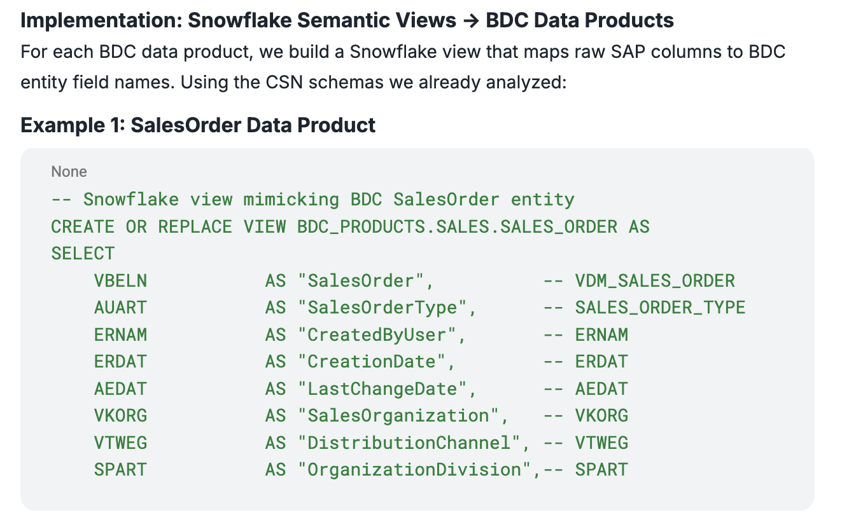
Example where Snowflake-first Makes Sense
Moving Company X from raw table extraction to BDC zero-copy would be very difficult today:
Only ~18 of their data footprint has matching BDC data products.
Their heaviest tables (CO, New GL, Costing, Production) have no BDC coverage
The presence of ECC-specific tables (FAGLFLEXA, BSIS/BSAS, COEP) suggests they'd need to migrate to S/4HANA first before BDC data products are even relevant
Also the customer has multiple ECCs and S/4HANA systems. A BDC formation can only connect to one S/4HANA system.
A Snowflake first approach solves the following problems:
Consolidate data from multiple ERPs
Provide robust CDC and SCD
Data is already in Snowflake. Use ORD-CSN to provide a harmonised view back to BDC.
Datasphere replication flows can be used to copy the data into Snowflake. As BDC becomes more robust, revisit.
BDC/Datasphere/ SAC consume harmonised views
Snowflake View that mimicks CDS BDC ORD-CSN entity fields
Data engineering consolidation in Snowflake
Raw Tables in Snowflake
S4 / ECC

Slide 15
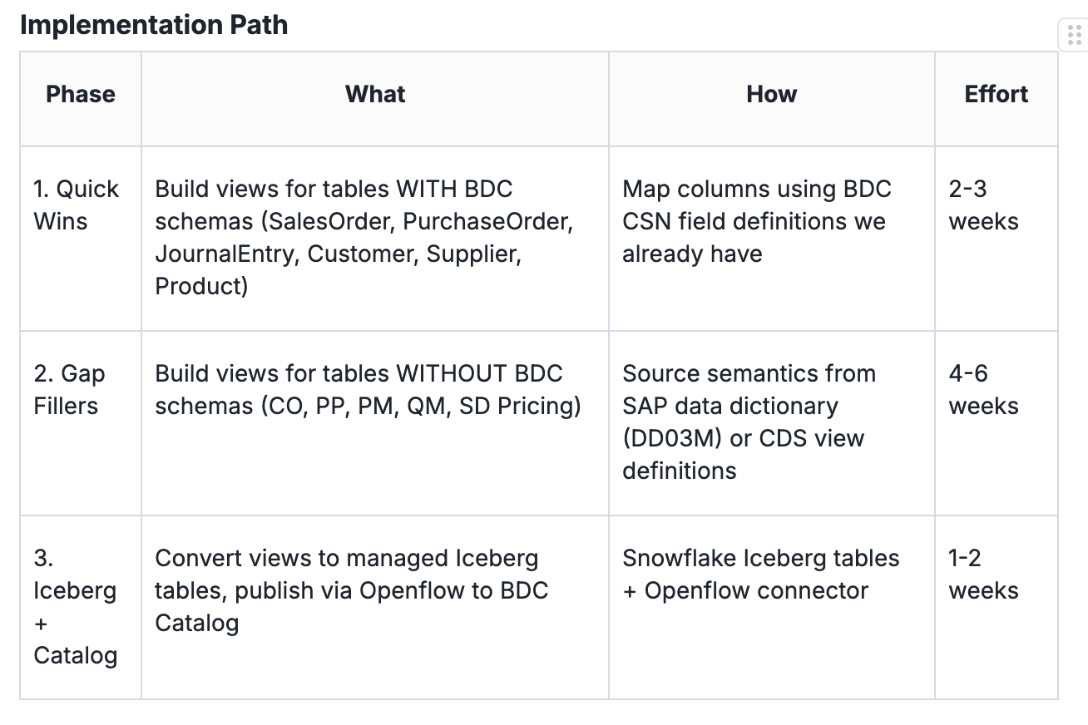
Snowflake Data Products To BDC Zero-Copy
Publish Snowflake Content into BDC Catalog
Build semantic views in Snowflake that match BDC data product schemas (using the CSN field mappings), or create new data products.
Publish Snowflake tables into BDC catalog.
BDC (Apache Spark) hits against Snowflake Apache Iceberg tables in a zero-copy fashion using its compute.
Datasphere/SAC/Intelligent apps consume these as if they were native BDC data products. SAC can also use generic connector to import/export data directly to/from Snowflake.
SAP BDC
Snowflake AI Data Cloud
4
Intelligent Apps / SAC
SF Horizon Catalog
2
Datasphere
Data Engineering
1
SAP BDC Catalog
3
SF Virtual Warehouse
Apache Iceberg
Apache Spark
Notes:
Metadata & Data Refresh
Snowflake->BDC
Snowflake Openflow UI used to publish Snowflake tables as “Remote Tables” into BDC where they will appear as Data Products in the BDC catalog.
BDC (Datasphere) uses the Snowflake JDBC connector and SQL Rest API to query Snowflake tables on demand. This uses Snowflake Virtual Warehouse computation, providing concurrency and performance.
SAC can also use generic connector to import/export data directly to/from Snowflake.

Slide 16
Snowflake AI Studio
Activate BDC Data Products, Semantic Views, and Agents in Snowflake
How to Easily Set Up & Share AI hitting against data from SAP BDC in Snowflake
Activate the Data Product from the BDC catalog.
Refresh the BDC Catalog and import the new data product. It activates as a Snowflake database.
Use Cortex Analyst to create/edit/automatically enrich semantic views on top of the DPs (now Snowflake tables).
Use Cortex Agent to create AI agents on top of multiple semantic views. Use NLQ to test.
Publish to Snowflake Intelligence which runs on top of multiple agents.
Share Snowflake data, applications, apis securely, economically, and performantly cross-cloud, cross-region, or back to BDC.
Check out other cool features in Cortex, such as Cortex Search, Document Processing, an using your own LLMs.
Snowflake AI Data Cloud
6
Marketplace
S/4HANA Private Cloud
SAP BDC
Snowflake Intelligence
Cortex AI & ML
5
1
SAP BDC Catalog
SF Horizon Catalog
4
2
Cortex Agents
SAP BDC Object Store
Cortex Analyst
SF VW
3
SAP Managed CDS Views (Operational Reporting Layer)
ABAP Push Replication Server / Apache Spark
Apache Iceberg
SF Storage
All Snowflake workloads (data engineering, data quality, marketplace, AI/ML, Snowflake Intelligence) can be used on incoming data, and data persisted in Snowflake
Notes:
Prerequisites
BDC trial or purchase
Intelligent app access: For SAP S/4HANA Cloud Private Edition system to function properly in Integration with SAP Business Data Cloud formations, you must possess the Cloud ERP Intelligence license
More details on the flow:
Catalog Linked Database (CLD) refreshes against BDC Catalog at regular intervals.
Snowflake queries directly against BDC Data using Snowflake compute. A. Query path optimization and execution is done in Snowflake.
B. Temporary token is requested for secure connection (api call). Snowflake hits directly against the BDC files. C. Caching of results at virtual warehouse and global services layer. Persisting in Snowflake allowed for performance reasons.*
All Snowflake workloads (data engineering, data quality, marketplace (restricted in Restricted GA), AI/ML, Snowflake Intelligence) can be used on incoming data.
*If the data is transformed in Snowflake it is no longer an SAP data product, and the rules of data product usage no longer apply.
Verify we do not use this: https://github.com/delta-io/delta-sharing/blob/main/PROTOCOL.md#read-data-from-a-table

Slide 17
HOW BDC WORKS

Slide 18

Introduction to SAP Intelligent Applications & Managed Data Products
Commercial: To access managed data products for Snowflake, customers have to buy intelligent applications.
SAP BDC
4
SAP Analytics Cloud (Intelligent Apps)
There are four components that are deployed when you activate an Intelligent Application:
An APRS replication job, that will replicate from SAP S/4HANA (not on-premise) SAP-managed CDS Views to hydrate the;
SAP Managed Data Products (MDP) in the Object Store , that are organised by:
An Analytic Model, that is maintained in Datasphere, that will;
Hydrate an SAP Analytics Cloud Dashboard.
Note: SAP is sharing its Data Products with its ecosystem (if you buy intelligent applications), not its higher level Analytic Model (sitting in Datasphere)
3
SAP Datasphere
SAP BDC Catalog
2
SAP BDC Object Store (MDP)
ABAP Push Replication Server / Apache Spark
1
S/4HANA Private Cloud Edition
SAP-released CDS Views
Hana DB
Notes:
https://community.sap.com/t5/technology-blog-posts-by-sap/sap-business-data-cloud-series-part-1-introduction-to-data-products/ba-p/14142919

Slide 19
Extend SAP S/4HANA Managed Data Products
SAP's extension points for Business Data Cloud (BDC) data products let you enrich pre-built SAP data with your custom fields, integrating them into SAP Datasphere and Analytics Cloud, often using CDS views for custom fields.
Provision BDC: Connect your S/4HANA system to SAP BDC.
Identify Data Product: Select an SAP-managed Data Product (e.g., Financial Actuals).
Extend CDS Views: Create custom CDS views that join the Data Product's CDS views with your custom tables.
Activate: Activate the Data Package in BDC to include these custom fields.
Consume: Access the enriched data in Datasphere for modeling or SAC for dashboards, or share with Snowflake for further data engineering, AI/ML or sharing.
CDS to Data product mapping:
4
SAP BDC
SAP Analytics Cloud (Intelligent Apps)
SAP Datasphere
2
SAP BDC Catalog
SAP BDC Object Store (MDP)
ABAP Push Replication Server / Apache Spark
1
Data Product | Data Source CDS
Sales Order | I_SalesOrder
Sales Order Item | I_SalesOrderItem
Billing Document Item | I_BillingDocumentItemDEX
S/4HANA Private Cloud Edition
SAP-managed CDS Views
3
Hana DB
Notes:
If you have already enhanced the underlying CDS views or entities in your SAP S/4HANA Private Cloud Edition (PCE) system before activating the corresponding data package or installing the intelligent application, the good news is that your custom fields will automatically flow into the Data Product upon activation. No additional steps required!
@AbapCatalog.sqlViewAppendName: 'ZEXTSALESORDER'
@EndUserText.label: 'Extension View for I_SalesOrder'
extend view I_SalesOrder with ZEXTEND_SALESORDER
{
ZZ1_Custom1_SDH as ZZ_CUSTOM1
}
Note: SAP-managed Data products cannot be activated individually. They only can be activated via Intelligent Application or on data package level. That means that all the data products within the data package or Intelligent Application are activated in one step.
Q: We need to extend an already installed data product. How should we handle this situation?
A: Currently, when you need to extend or change an existing data product, the process On the SAP S/4HANA source side, any changes you make will be handled within the existing framework. On the SAP BDC side, however, you must either deactivate the entire data package or uninstall the intelligent application and then activate or reinstall it to incorporate the new changes to the data product. It is not the most efficient way to handle a small change of adding new field to the data product. The product team is aware of this and is working on a solution to provide more granular control at the data product level, which would allow for more targeted updates in the future.

Slide 20
SAP BDC Custom Data Products
Warning: Datasphere Business Content only covers S/4HANA (e.g. on-premise), not ECC. Business Content does not convert 1-to-1 to managed data products (once you move your on-prem to Private Cloud.)
SAP BDC
SAP Analytics Cloud
5
SAP Datasphere
3
A customer has a custom CDS entity in SAP S/4HANA and wants to harmonize its data with SAP-managed data products. We’ll demonstrate how to create a custom data product based on that custom CDS entity
Extend a CDS entity in S/4HANA
One to several Replication Flows, that will replicate from S/4HANA CDS Views to hydrate the;
SAP Datasphere local tables (bronze) where you can create transformation flows with Datasphere (silver) and then
store in the Datasphere Object Store (data product), or Bucket (not shown), or Kafka Topic (not shown), and/or
Optionally hydrate an SAP Analytics Cloud Dashboard.
SAP BDC Catalog
4
2
Datasphere Object Store
Datasphere Replication Flows
(ODP/CDC Eng, SLT)
Tables, CDS, Extractors
1
S/4HANA on-premise / ECC
AnyDB

Slide 21
How is BDC Connect for Snowflake different from Delta Sharing?
UNDER NDA |Snowflake Confidential
For Databrick Delta Sharing:
You need to set up a Delta Sharing Server
Optimizations, such as pruning and result caching, are not applied on Delta-Shared objects like they are in Snowflake; leading consumers to pay compute cost penalty per query.
You can only have tables only (other richer objects views, functions, and apps are not supported)
Managed Delta Sharing restricts providers to sharing with consumers who are either:
Databricks customers using the premium edition with Unity Catalog, or
Consumers using clients that support the Delta Sharing protocol
SAP BDC Connect for Snowflake does not use Delta Server, does not use Databricks or Unity Catalog . It does use Delta Table Protocol.
Snowflake uses :
Apache Iceberg table format,
it optimizes query performance through pruning and result caching, both in the virtual warehouse memory and in the general services layer
Hits directly against the BDC object store to get the best performance.
Notes:
From Amit Gupta
https://docs.google.com/document/d/1W185yhf61XNqWhEVOfWzFuquFtVGNhTERvew_IPvmfo/edit?usp=sharing
https://docs.google.com/presentation/d/1b9ofXmKkyPw1XFmCx4MbEK8S2DSGvSRMa9JeldmrG1k/edit?usp=drivesdk
https://docs.google.com/presentation/d/1b9ofXmKkyPw1XFmCx4MbEK8S2DSGvSRMa9JeldmrG1k/edit?usp=sharing

Slide 23
WIP

Slide 24
BDC Data Flow
L0 (Raw)
L1 (Bronze Schema)
L2+ (Silver Schema)
Catalog Linked to BDC
Consolidation of L0
Consumption View – Dynamic Tables
Best practices for SAP BDC
RAW Layer – Data Products as is from SAP BDC
Bronze Layer – Combination of multiple individual databases into single use case related database with multiple schemas
Silver Layer – Dynamic Tables updated on frequency applicable to SAP BDC refresh
The listing contains L0+L1
CUSTOMER
CUSTOMER
CUSTOMER
PRODUCT
PRODUCTS
PRODUCTS
SALES ORDERS
SALES ORDERS
SALES ORDERS
CRM Data
CRM Data
CRM
L0 and L1 – Will incur SAP Premium Cost

Slide 25
Once data is enriched in Snowflake (e.g., through a join, union, AI/ML processing, etc.) it is no longer a BDC data product and no longer subject to the rules mentioned in our BDC supplement and that he results may be stored within the target system (e.g.Snowflake Silver Layer) and used as a native data object owned by the customer that can also be used for business purposes not directly related to this customer. Customer is asking why this is not mentioned in our BDC supplement.
The language in our supplement was finalized with SAP legal team’s counsel. They understood our intent behind the language and advised us on the legal language needed. ) In the supplement’s legal language, the definition makes clear what a “Data Product” (note the capitalization) is and denotes a specific delivery of an object from BDC. The moment that object is altered, it is no longer the “Data Product” from BDC (now a regular “data product” perhaps). Therefore, it is unnecessary to change the current language.
Customers may allow third-party connectors to temporarily store or materialize data products on such a third-party connectors solely for performance optimization purposes. What is the process : should the customer request the authorization to SAP to do such temporary materialization documenting the performance issue or should they just inform SAP that they are temporarily materializing some data products due to performance issue or don’t they have to do anything and proceed ? What is the threshold to define performance issue requiring an optimization ? Is it at the sole appreciation of the customer ? There is no need for notification, and the judgment of temporary materialization for performance reasons is at the discretion of the customer. We do not have any defined thresholds. This is also at the discretion of the customer.
Storing

Slide 26
One Org
Account 2
Account 1
Marketplace
S/4HANA Private Cloud
SAP BDC
Cortex AI & ML
1
SAP BDC Catalog
SF Horizon Catalog
SF Horizon Catalog
SAP BDC Object Store
SF VW
SF VW
SAP Managed CDS Views (Operational Reporting Layer)
ABAP Push Replication Server / Apache Spark
Apache Iceberg
Inter-Org Sharing
2
3
4
5
6

Slide 27
Inter-Org
SAP Snowflake (Org #2)
Existing Snowflake AI Data Cloud (Org #1)
Marketplace
S/4HANA Private Cloud
SAP BDC
Cortex AI & ML
1
SAP BDC Catalog
SF Horizon Catalog
SF Horizon Catalog
SAP BDC Object Store
SF VW
SF VW
SAP Managed CDS Views (Operational Reporting Layer)
ABAP Push Replication Server / Apache Spark
Apache Iceberg
Inter-Org Sharing
2
3
4
5
6

Slide 28
BDC Cost Levers
non-BDC Cost Levers
S/4
CDS CPU load on S/4 machine
BDC
Managed DPs - compute costs for APRS & Apache Spark
Customer DPs - need Datasphere Compute, storage, object store. DP Builder to replace some of this Q2-Q3 ‘26
BDC Connect Premium fee.
Snowflake
S/4
Raw table CDC log capture.
3rd Party ETL/ELT
Snowflake
Data engineering
DP development through Cortex Code
AI
S/4 CDS load
APRS / Apache Spark
Datasphere / Data Product Builder
BDC
Premium
Snowflake
S/4 CDC
Fivetran
Snowflake

Slide 29
Inter-region using Snowflake Internal Marketplace
S/4H PCE
BDC
BDC Connect for Snowflake (api calls, premium charge, no egress cost)
Snowflake #2
(catalog linked databases)
Apache Iceberg tables
(egress)
Snowflake #1
AUS AWS
AWS Ireland
Does this go across private?
Across AWS backbone. Still in Snowgrid. Abhi

Slide 30
Customer on BTP Datasphere
S/4H PCE
BTP
Datasphere
Gen2 Bucket (premium outbound - volume based)
SF
(catalog linked databases)
Apache Iceberg tables.
SF
Datashare
EU AWS
S/4H PCE
BDC
Datasphere
Object Store
BDC connect zero-copy
SF
(catalog linked databases)
Apache Iceberg tables
SF
Datashare
AUS AWS
AWS Ireland

Slide 31
Inter-region Direct
S/4H Pub
BDC
BDC Connect for Snowflake (inter-region egress cost, api calls premium charge)
SF
AWS
SF
Azure
AWS

Slide 32
s/4
bdc
sf
ECC/ s/4
BW 7.5
BDC
BW Private Cloud Edition
Capacity Units
(2030)
zero-copy
sf
ECC/ s/4
sf

Slide 33
s/4
bdc
sf
Bdc
Intelligent Applications
Datasphere -Analytics Model
S/4 Private (rise) (Core Data Services views)
or Public (grow) Cloud Edition
BDC
Curated data products
1 to many CDS -> DP (semantic-level information)
zero-copy
Snowflake
Share
ECC/ s/4
CDS
Or Raw tables
SF (15 enterprise data platforms)

Slide 34
Devon Energy ETL
S/4 1
Datasphere
Replication flows (0 material)
Snowflake
Confluent
SF streaming 15 cred
S/4 2
Snowflake
Datastreams
S/4 3
Snowflake
Zero copy
Notes:
Is Confluent optimizing the data streams. Using as key for pass-through.

Slide 35
DBX Delta Sharing
100 queries * hour * 1min
1 TB * 1min * 25%
10 TB / refreshed hourly
1 TB * 1 min
Hyper scalar price
1 TB
Delta Share server is a single point of failure
Snowflake pruning & caching
Virtual warehouse cache
1 TB
1 query * 1min * 60%
10 TB / refreshed hourly
1 query * 20 sec. (80% of data already in VM from 1st query, diff query hits SAP
50 GB

Slide 36
Only SAP Data and/or non-SAP
BDC zero copy
(xK/tier/month)
Snowflake
In calculator:
1600 complex Queries, 0 Transforms, AI yes
Value: Easier access to PBI, AI
Cheaper than persisting.
Double rows, make all complex (20K-40K/month)
Reporting included
(BDC run costs +20K)*12= 384K to 624K
L0
L1 View
L0
L1 View
L0
L1 View
Materialize in Snowflake
BDC zero copy
(xK/tier)
Snowflake
In calculator:
0 concurrency - no gold layer to calculate
Double the DTs
0 AI (20K/month)
Reporting not included (add 15-20K)
(BDC costs +20K+20K)*12= 624K
L0
DT
L1
DT
L2
L0
DT
L1
DT
L0
DT
L1
DT

Slide 37
Only SAP Data and Non-SAP Data
BDC ETL
(6K/tier/month) can be smaller because don’t need object store
Premium outbound 1 block / 20 GB/d = 500 CU/day
400 GB/Month= 8500 CU
+Data Integration (720 hours = 500 CU)
Replication Flow
(bulk)
Snowflake
BDC run costs + 8.5K+.5K+Snowflake (CDC, Merge, Updates transform) = 21K+
Replication Flow
(streaming)--50% of copy into, but cost of streaming app

Slide 38
Table
60 TB
Core Data Services
Table
Table
Table
SF - Database
5TB
Table
Cds S/4
Cds S/4
Cds S/4
BDC DP
40TB
Cds S/4
CDS entity
Table
Schema
Table
Table
Table
tables
tables
Cds S/4
tables
Cds S/4
BDC DP
Cds S/4
Cds S/4
Cds S/4
Ingestion,
Transformation,
Reporting 400 -
AI
S/4
BDC

Slide 39
Datasphere
JDBC
Snowflake storage (FDN)
Apache Spark
Apache Iceberg Table (AWS S3)
ME- David R.
100 TB
Snowflake account
AWS Frankfurt
$0 compute
$23/TB/month
Consumer - David S.
1 hour - XS Virtual Warehouse.
$3

Slide 40
Insud Pharma
Possible scenarios to test:
Scenario 1: every hour copy DP to Snowflake. CDC works?
Scenario 2: Use agent directly on ZeroCopy
ECC
BDC RF
Datasphere object store
zc
Snowflake
20 USD
Dynamic Table (land data in SF)
ECC
BDC
Datasphere - 128 GB
Sap Analytics Cloud
BDC Connect
Pay for Custom DP
Ingestion = 2min*24*$3
Transform = 4h* 30* $3 (xs vwh)
Reporting = 8h* $12 (m vwh)
= $360+$96 = $454
$454*.604*$1.25= $343
$454+$343= $797
Intelligent Application
Data products
Datasphere Replication Flow from ABAP system SAP Note: 2890171

Slide 41
By Building your own Universal Data Model you can:
Keep the lights on during your transition from ECC to S/4.
Consolidate data coming from multiple ECCs, S/4, and other enterprise system
Use up-to-date SAP Data Product semantic definitions from SAP (ORD-CSNs automatically shared, or leverage api.sap.com)
Incorporate non-SAP systems into your data model
Use Snowflake Cortex Code (Coco) to:
build robust imperative data flows in DBT
or declarative data flows using Dynamic Tables
Assemble digest and act upon metadata and documentation to build your analytic models.
Finance Universal Data Model Built in Snowflake
Agents
Semantic Views
F1 | F2 | F3 | F4 | F5 | F6 | F7 | F8 | F9 | F10 | F11 Data product definitions–grouping of fields
F1 | F2 | F3 | F4 | F5
F1 | F2 | F3 | F4 | F5
F11 | F22 | F200 | F400 | F500
F1 | F2
VBAK
Vxxx
ACDOCA
Table
ECC
S/4 HANA
non-SAP

Slide 42
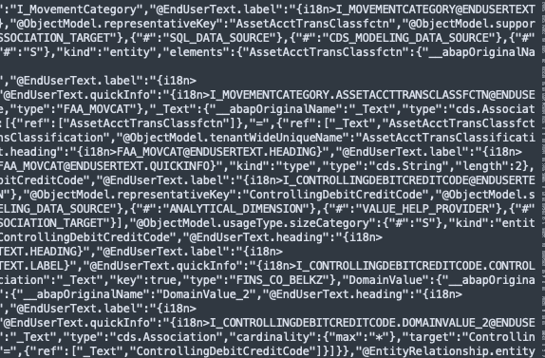
Datasphere
Analytic Model
Star, snowflake, puppini, wide table
ORD-CSN
Semantic View
Cortex Code
-skill available
BDC
Data product
Data product

Slide 43
BDC
Foundation Services
Sap S/4 Cloud Public or Private
Curated Data Product
Snowflake
anyDB
Object Store
Sap bw
Sap bw Private Cloud Ed.
Datasphere

